Slide 1

Inpatient Evaluation of Acute Dyspnea
Objectives
1. Develop a broad differential for causes of acute dyspnea
2. Construct a framework for the evaluation of acute dyspnea
3. Identify causes of acute hypoxemia and how to differentiate them
PRACTICE CASES

Slide 2

1. Causes of Acute Dyspnea
Airways
Anaphylaxis, angioedema
Mucus plugging, airway stenosis
Bronchoconstriction (COPD, asthma)
RESPIRATORY
Alveoli
Fills alveoli
Collapses alveoli
Click here
Blockage or narrowing of any part of the respiratory system will cause dyspnea!
Blood = DAH
Pus = pneumonia
Water = edema
Atelectasis
Pleural process (blood, pus, water, air)
Vessels
Pulmonary embolism
Diaphragm dysfunction
Abdominal pressure
MUSCULOSKELETAL
Myocardial infarction
Arrhythmias
Valvular disease
Pericardial disease
CARDIAC
Anxiety
Acidosis (metabolic and respiratory)
Anemia
The 3 “A’s”
2 EVAL
3 HYPOXEMIA

Slide 3
2. Evaluation and Diagnostics
How to Evaluate
Airways
Anaphylaxis, angioedema
Physical exam
Mucus plugging, airway stenosis
Bronchoconstriction (COPD, asthma)
Alveoli
Fills alveoli
Collapses alveoli
ABG
Blood = DAH
Pus = pneumonia
Water = edema
Atelectasis
Pleural process (blood, pus, water, air)
CXR
Vessels
CTPE
Pulmonary embolism
Diaphragm dysfunction
Abdominal pressure
CXR, ABG/ VBG
Physical exam
Myocardial infarction
Arrhythmias
Valvular disease
ECG
Pericardial disease
Physical exam
Anxiety
Acidosis (metabolic and respiratory)
Anemia
BMP, ABG/ VBG
1 CAUSES
3 HYPOXEMIA
CBC
More Eval

Slide 4
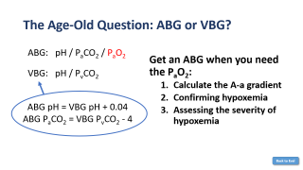
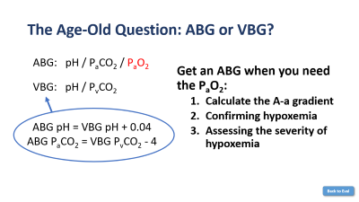
2. Evaluation and Diagnostics
How to Evaluate
Airways
Anaphylaxis, angioedema
Physical exam
Mucus plugging, airway stenosis
Bronchoconstriction (COPD, asthma)
Important diagnostic tests:
CXR
ECG
CBC
Alveoli
Fills alveoli
Collapses alveoli
ABG
Blood = DAH
Pus = pneumonia
Water = edema
Atelectasis
Pleural process (blood, pus, water, air)
CXR
ABG vs. VBG
Vessels
CTPE
Pulmonary embolism
Diaphragm dysfunction
Abdominal pressure
CXR, ABG/ VBG
Physical exam
Myocardial infarction
Arrhythmias
Valvular disease
ECG
Pericardial disease
Physical exam
Anxiety
Acidosis (metabolic and respiratory)
Anemia
BMP, ABG/ VBG
1 CAUSES
3 HYPOXEMIA
CBC

Slide 5
3. Hypoxemia
O₂
Dyspnea ≠ Hypoxemia
O₂
Alveoli
PaO₂ is measured on an ABG.
Normal PaO₂ is 75 -100.
Hypoxemia = low PaO₂
Not all causes of dyspnea cause hypoxemia.
O₂
O₂ diffuses from the alveoli across lung parenchyma into the capillaries where it dissolves. The concentration or partial pressure O₂ in our arterioles is the PaO₂.
Lung parenchyma
PaO₂
Capillary
Click Anywhere to Advance Slide Animations and Text
1 CAUSES
2 EVAL

Slide 6
Causes of Hypoxemia
Decreased FiO₂and decreased diffusion capacity do not occur acutely and do not need to be considered as a cause of acute hypoxemia in the hospital.
There are 5 causes of hypoxemia.
P_{A}O₂
Alveoli
↓ FiO₂
O₂
Normal A-a gradient
O₂
Hypoventilation
Lung parenchyma
V/Q mismatch
O₂
PaO₂
Capillary
Shunt
↑ A-a gradient
↓ diffusion capacity
A-a gradient is the difference in the P_{A}O₂ alveolar O₂) and PaO₂ (arterial O₂). There is normally minimal difference because there are few barriers to diffusion. Click on ↓ FiO₂
or Hypoventilation for additional information.
The A-a gradient = P_{A}O₂ – PaO₂
P_{A}O₂ = FiO₂ x (P_{atm} – P_{H2O}) – P_{a}CO₂ (1.25)
PaO₂ and PCO₂ are obtained from an ABG
The expected A-a gradient = age / 4 + 4
An elevated A-a gradient occurs when there is a disruption in the alveolar-capillary unit. Pathology in the alveoli (aka ventilation), lung parenchyma or capillaries (aka perfusion) can result in hypoxemia with an elevated A-a gradient.
1 CAUSES
2 EVAL

Slide 7
Hypoventilation
P_{A}O₂
Alveoli
↓ FiO₂
O₂
CO₂
O₂
Hypoventilation
Lung parenchyma
V/Q mismatch
O₂
CO₂
PaO₂
CO₂
Capillary
Shunt
Ventilation, which is determined by respiratory rate and tidal volume (volume of breaths) creates opportunities for gas exchange. Hypoventilation ↓ elimination of CO₂ resulting in ↑ PCO₂. Elevated PCO₂ effectively ↓ “space” for O2, and subsequently results in hypoxemia. Examples include CNS depression, opiates/ benzodiazepines, neuromuscular weakness, diaphragmatic dysfunction.
↓ diffusion capacity
1 CAUSES
2 EVAL

Slide 8
V/Q mismatch
O₂
O₂
P_{A}O₂
Alveoli
↓ FiO₂
V
O₂
Hypoventilation
Lung parenchyma
V/Q mismatch
Q
PaO₂
Capillary
Shunt
Ventilation (V) - Perfusion (Q) mismatch (or V/Q mismatch) occurs when there are areas of V without Q or vice versa. This can occur in the presence of smaller alveolar filling/collapsing process, obstructive airway disease, pulmonary vascular disease, or pulmonary embolism.
↓ diffusion capacity
1 CAUSES
2 EVAL

Slide 9
Shunt
O₂
Hypoxemia that does not correct with 100% O₂ suggests a large shunt.
O₂
O₂
P_{A}O₂
Alveoli
↓ FiO₂
V
Hypoventilation
Lung parenchyma
V/Q mismatch
Q
PaO₂
Capillary
Shunt
Shunt occurs when there is perfusion (Q) without ventilation (V). This can occur in the presence of a physical shunt or with a large alveolar filling/collapsing process. Things that fill the alveoli include blood, water, pus.
↓ diffusion capacity
1 CAUSES
2 EVAL
CASES

Slide 10


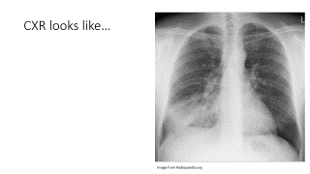
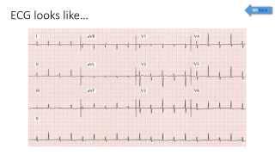
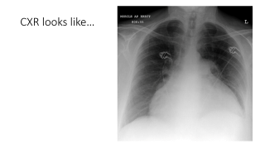
CASE 1
CASE 2
CASE 3
84 M with a history of HLD, CAD presents with 1 d of dyspnea.
VS: T 38C, HR 110, BP 125/70, RR 24, S_{a}O₂ 92% on RA
Exam:
Tachycardic, regular rhythm, no murmurs
Crackles in the R lower lung fields
74 F with a history of NHL presents with 1 d of dyspnea.
VS: T 36C, HR 110, BP 98/60, RR 24, S_{a}O₂ 94% on RA
Exam:
Tachycardic, regular rhythm, elevated JVP
Lungs clear
25 F with type 1 DM a presents with 1 d of dyspnea.
VS: T 36C, HR 110, BP 125/70, RR 32, S_{a}O₂ 99% on RA
Exam:
Tachycardic, regular rhythm
Tachypneic without increased work of breathing, clear lungs
Diagnostic testing
Diagnostic testing
Diagnostic testing
CXR is clear.
Focal abnormalities on lung exam should prompt a CXR.
CXR here shows a boot shaped heart which could indicate cardiomegaly or pleural effusion.
CXR
CXR
CXR
BMP showed Na of 128, K 4.5, HCO3 8, BUN 32, Cr 2.2. CBC showed a WBC of 12.5k, Hgb 10.2.
BMP was wnl. CBC showed a WBC of 9.5k, Hgb 10.2.
BMP/ CBC
BMP was wnl. CBC showed a WBC of 13.5k, Hgb 10.2.
BMP/ CBC
BMP/ CBC
VBG: 7.1/29/-/9. There are no concerns about hypoxemia so a VBG is sufficient in this case.
A blood gas is likely not needed in this case. ABG shows 7.48/32/65/22.
A blood gas is likely not needed in this case. ABG shows 7.48/32/86/22.
ABG/ VBG
ABG/ VBG
ABG/ VBG
ECG shows sinus tachycardia and nonspecific T wave changes.
ECG shows sinus tachycardia without signs of ischemia.
ECG shows signs of electrical alternans, which can be seen in pleural effusion.
ECG
ECG
ECG
Dyspnea and tachypnea from respiratory compensation of severe metabolic acidosis (DKA)
Dyspnea and hypoxemia 2/2 to RLL pneumonia.
In the context of hypotension, elevated JVP, and pericardial effusion, she likely has tamponade.
FINAL DIAGNOSIS
FINAL DIAGNOSIS
FINAL DIAGNOSIS

Slide 11
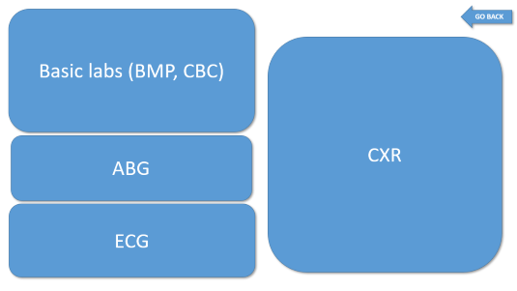
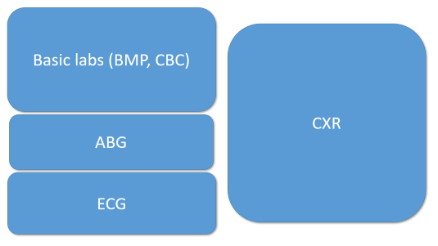
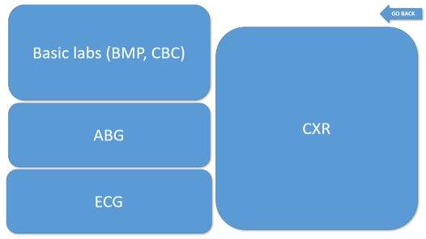
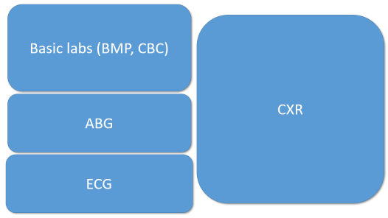
CASE 4 (part 1)
CASE 4 (part 2)
64 M with a history of R-sided renal cell cancer admitted for a R nephrectomy.
On post-op day 1, he developed acute onset shortness of breath and chest and abdominal pain.
VS: T 37.1C, HR 140, BP 90/60, RR 28, S_{a}O₂ 96% on RA
Tachypneic, diminished lung sounds at bases. Abdomen distended and tender
On post-op day 5, he developed acute onset shortness of breath and chest pain.
VS: T 37.1C, HR 140, BP 90/60, RR 28, S_{a}O₂ 82% on RA
Tachypneic, lungs otherwise clear. Tachycardic without murmurs.
FINAL DIAGNOSIS
BMP and CBC are wnl. CXR: clear lung fields, ECG: sinus tachycardia. ABG shows evidence of hypoxemia (PaO₂) with an elevated A-a gradient (click for A-a gradient calculation).
The most likely etiology here of elevated A-a gradient (click for differential) is V/Q mismatch. In the presence of a normal CXR, this is likely a PE.
FINAL DIAGNOSIS
CXR: low lung fields, ECG: sinus tachycardia. ABG: normal without hypoxemia. CBC shows severe drop in hct. This is dyspnea 2/2 to severe anemia likely from post-op bleeding.

Slide 12
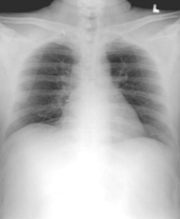
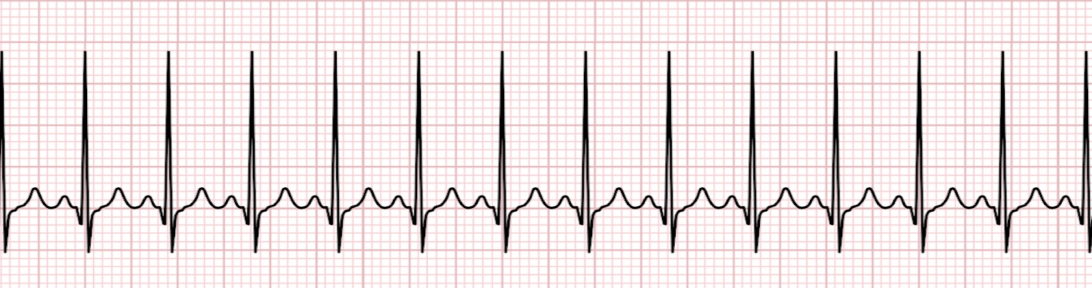
Basic labs (BMP, CBC)
GO BACK
140
98
12
112
4
24
1.0
CXR
9.8
5.8
9
350
14
350
30
19
ABG
ABG: pH 7.43
PCO₂ 45
PO₂ 80
HCO₃ 24
ECG

Slide 13
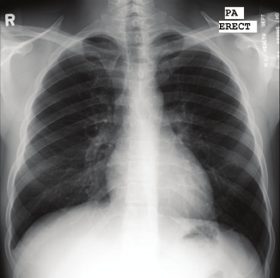
Basic labs (BMP, CBC)
GO BACK
140
98
12
112
CXR
4
24
1.0
14
9
350
42
ABG
ABG: pH 7.43
PCO₂ 32
PO₂ 50
HCO₃ 24
ECG

Slide 14
GO BACK
Calculate the A-a gradient
pH 7.43 / PCO₂ 32/ PO₂ 50 / HCO₃ 24 (on room air)
Calculate an A-a gradient!
P_{A}O₂ = 150 – 32 x (1.25)
P_{A}O₂ = 110
P_{A}O₂ - P_{a}O₂ = 110 – 50 = 60
Expected A-a gradient = Age/4 + 4
= 64/4 + 4
= 20
Elevated A-a gradient!

Slide 15
GO BACK
Causes of an elevated A-a gradient
Non-anatomic shunts are evident on CXR
Alveoli
V
Shunt (anatomic, large alveolar filling process)
V/Q mismatch (obstructive lung disease, pulmonary vascular disease/PE)
↓ diffusion capacity
Lung parenchyma
Q
Capillary
Does not typically happen acutely

Slide 16
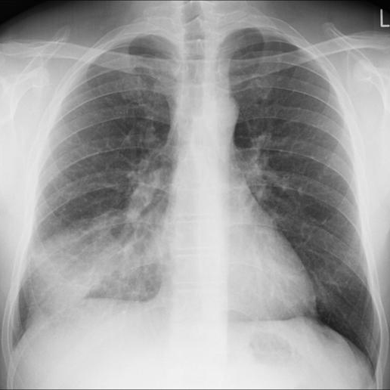
CXR looks like…
GO BACK
Image from Radiopaedia.org

Slide 17
The Age Old Question: ABG or VBG?
GO BACK
ABG: pH / P_{a}CO₂ / P_{a}O₂
Get an ABG when you need the P_{a}O₂:
Calculate the A-a gradient
Confirming hypoxemia
Assessing the severity of hypoxemia
VBG: pH / P_{v}CO₂
ABG pH = VBG pH + 0.04
ABG P_{a}CO₂ = VBG P_{v}CO₂ - 4

Slide 18
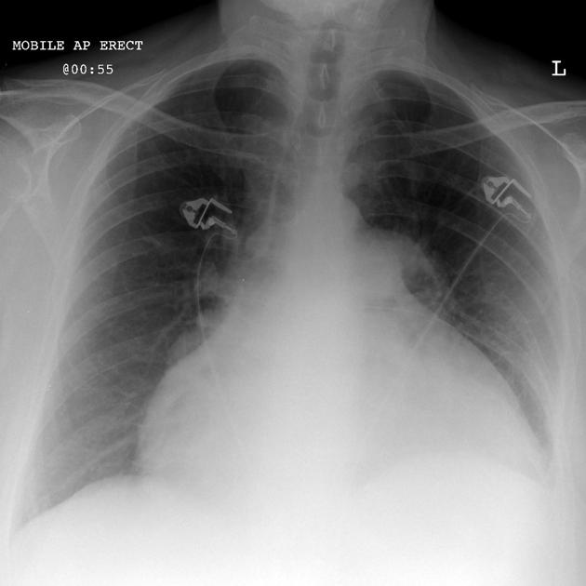
CXR looks like…
GO BACK

Slide 19
The Age-Old Question: ABG or VBG?
ABG: pH / P_{a}CO₂ / P_{a}O₂
Get an ABG when you need the P_{a}O₂:
Calculate the A-a gradient
Confirming hypoxemia
Assessing the severity of hypoxemia
VBG: pH / P_{v}CO₂
ABG pH = VBG pH + 0.04
ABG P_{a}CO₂ = VBG P_{v}CO₂ - 4
Back to Eval

Slide 20
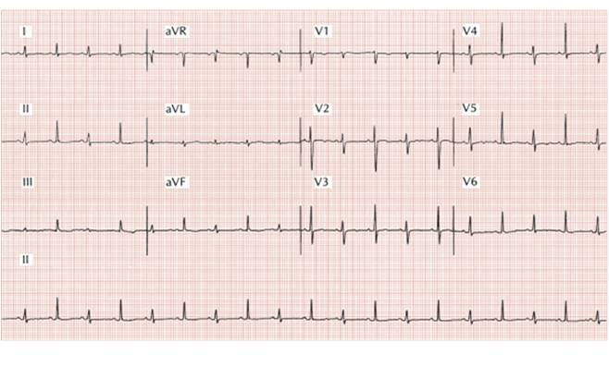
ECG looks like…
GO BACK

Slide 21
Acute Dyspnea / Hypoxemia — Framework Notes
The differential, the evaluation toolbox, and the 5-cause / A-a-gradient framework are timeless physiology, verified current (June 2026). Notes below reinforce, not replace, the standing teaching.
Two equations to keep on the board: A-a gradient = PAO2 − PaO2; PAO2 = FiO2 × (Patm − PH2O) − PaCO2/0.8 (≈ 150 − 1.25×PaCO2 on room air). Expected A-a = age/4 + 4 — so a 64-year-old expects ~20, not 16.
5 causes of hypoxemia: low FiO2 and low diffusion capacity (NORMAL A-a, and not acute inpatient causes), then hypoventilation (normal A-a, high PaCO2), V/Q mismatch, and shunt (both ELEVATED A-a). Shunt is the one that does NOT correct with 100% O2.
Point-of-care lung ultrasound (BLUE protocol; Lichtenstein) is now a routine bedside adjunct — rapidly distinguishes cardiogenic edema, pneumonia/consolidation, pneumothorax, and effusion with high sensitivity, complementing CXR/ABG/ECG/CBC.
ABG vs VBG: get an ABG when you need the PaO2 (to confirm/grade hypoxemia or compute the A-a gradient). VBG estimates: ABG pH ≈ VBG pH + 0.04; ABG PaCO2 ≈ VBG PvCO2 − 4.

Slide 22
Take-Home Points
1. Build the dyspnea differential by system: respiratory (airways / alveoli / vessels), cardiac, musculoskeletal, and the "3 A’s" (anemia, anxiety, acidosis). Respiratory and cardiac are most common.
2. The core work-up toolbox: CXR, blood gas, CBC, ECG — add POCUS at the bedside.
3. Dyspnea ≠ hypoxemia. Hypoxemia = low PaO2 (normal 75–100); confirm it on an ABG.
4. Sort hypoxemia by the A-a gradient: normal (hypoventilation, low FiO2) vs elevated (V/Q mismatch, shunt; low diffusion is chronic). Shunt fails to correct with 100% O2.
5. Get an ABG over a VBG whenever you need the PaO2 — e.g., to calculate the A-a gradient.

Slide 23
Attribution & Optimization Notes
Original lesson: “Inpatient Evaluation of Hypoxemia,” TeachIM.org (updated Dec 2022). Two interactive boards published: Teaching (Presenter) and Learning (Learner).
Author: Yilin Zhang MD (expert review pending, per the lesson page).
Source URL: teachim.org/teaching_material/inpatient-evaluation-of-hypoxia/
License: Creative Commons Attribution-NonCommercial 4.0 International (CC BY-NC 4.0). Non-commercial educational use only.
Correction made on BOTH boards (single-run XML, animations preserved): Case 4 expected A-a gradient "= Age/4 + 4 = 64/4 + 4 = 16" -> "= 20" (64/4 + 4 = 20; the measured 60 is still elevated, conclusion unchanged).
Human review: Case 3 (tamponade) CXR line reads "boot shaped heart which could indicate cardiomegaly or PLEURAL effusion" — given elevated JVP, electrical alternans, and the pericardial-effusion/tamponade diagnosis, this likely should read "pericardial effusion." Left unchanged pending author confirmation (also: "boot-shaped" is itself atypical wording for pericardial effusion).
Companions copied & linked: Learner board (SOB-Learner-Final.pptx, same A-a fix) + handout (SOB-worksheet.pdf, reviewed unchanged). Context source-cited: BLUE-protocol lung US (Lichtenstein). Medical content should be clinician-reviewed before teaching.

